Slide 1

AQUAVIEW+ : Cloud Enabled Data Assembly and Dissemination System

Slide 2


Pain Points: NOAA Fisheries Data Management
Metadata: Improving independent understandability and interoperability across NMFS as data are collected and managed in unique formats and variables
Confidentiality: Appropriately handling and providing access to commercially sensitive or PII data
Flexibility: Ability to handle multi-source data streams
Access: Meeting FAIR Standards to improve findability, accessibility, integration, and reusability across the NOAA data enterprise and beyond
Availabilty: Providing a common data framework across the NOAA data enterprise
2

Slide 3

Objective
Objective: To rapidly enhance NOAA’s infrastructure and tools for archive, access, and usability of ocean data and unlock the full potential of future and past collections.
The AQUAVIEW+ Initiative will build off AQUAVIEW’s existing federated platform to fully leverage the cloud and the latest database technologies, resulting in expanded use of NOAA data in critical decision support contexts that require integration of data currently trapped in silos across NOAA. With simplified access to NOAA Fisheries petabyte-sized holdings of data, scientists and resource managers will be able to more comprehensively and more quickly find and take advantage of disparate data for report generation, analysis, and other needs as identified as the Data Assembly Hub comes online.
3

Slide 4
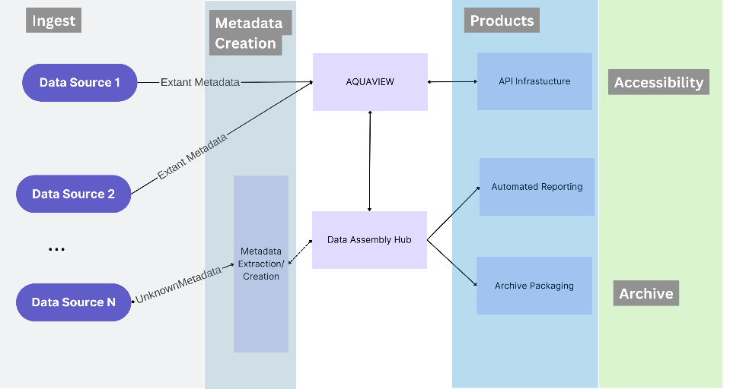
Complementary Components
AQUAVIEW
Developed as a metadata aggregator and API ecosystem for NOAA data
Provides integrated simple access to future and archived data, wherever it might be stored (e.g. a federated system)
Uses S3 as data repository with MongoDB as flexible, future-proof metadata library
Proven system ready for expanded data for testing and use
Data Assembly Hub
Provides repeatable data pipelines for report/archive package generation
Uses AQUAVIEW as its metadata repository
Generates metadata on ingest
Provides AI-ready data for use via AQUAVIEW’s API ecosystem
System development underway in September 2023

Slide 5
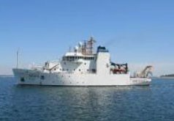
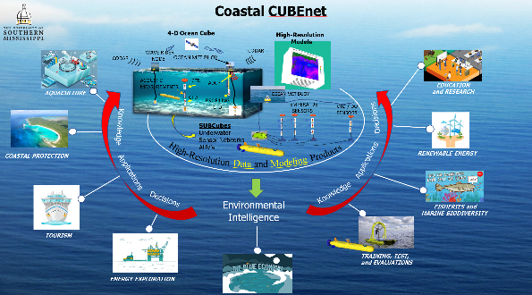
AQUAVIEW’s Current Data Delivery Model
S3 *
(AWS)
*Also works with other cloud-based systems: Google, Microsoft, etc
Upload Methods
Near RT Uploads (OceanCube)
Older Data Ingestion
Federated Data Stores
Meta Data Compilation and Access
AQUAVIEW SUPPORTS API Development:
ex. Archiving, Visualizations
AQUAVIEW
External Partners
External academic partners can use the uploaded data and metadata to initialize and/or ground-truth their regional ocean models or join with other data
Upcoming Data Assembly Hub work will allow for automated report generation/archive package development/deployment
API’s allow scientists to build their own tools for finding and accessing the underlying data efficiently

Slide 6

AQUAVIEW Tech Details
Download Requested Data
Users
MongoDB
Metadata
Set of Python Applications/MongoDB for metadata storage coupled with federated cloud-based data
Collects and merges metadata from current operations or previously generated data
Can provide at or near-real-time support for data collections
Has API system to enable access from outside organizations with ability to limit data access via “tags” on specific datasets/types/etc.
Can enable purpose-built applications from database
Search/Preview Data
Point to Data Storage Location
Web
UI
Update or Curate Data
Web Interface for Search and Preview of Data
Data Annotation Engine
Stream Video/Imagery
Update Annotations
Data Storage
Load Data for Map Layers
Provide Data for Algorithms
Visualize Geo-location of Data
ESRI Map Interface
Compute Cluster
Restful
API
Programming Interface for Search and Selection of Data
Run Algorithms Using Data in Storage

Slide 7

Data Assembly Hub Tech Details
Will provide for automated metadata extraction
Reproducible data pipelines (including data transformations, etc.) for report generation or other analyses
Git style change tracking to lower storage overhead
Formats/QC metadata for joining into the larger data system
Data access can be controlled via “tags” within the data system
Works with AQUAVIEW API system
Will allow for custom archive format script development for automation of archiving data
INSERT A SEMI-COMPLEX FLOW DIAGRAM OF UxS DAH. And state that it is your current UxS work. This will demonstrate that they are not starting from scratch.
(TOO HIGH LEVEL AND YOU’LL LOOK LIKE THIS IS AN EASY THING TO DO. TOO LOW LEVEL AND NO ON WILL BE ABLE TO FOLLOW IT.)

Slide 8

Initial Outcomes
AQUAVIEW+Data Assembly Hub will create a platform that achieves the following goals:
Demonstrate and learn how a federated cloud archive could be used to improve timely, efficient, and consistent access of data for broad use by NOAA and the public
Leverage cloud-based workflows to improve production of decision support tools, including ingestion, metadata creation, product development, archival packaging and accessibility
Build API ecosystems for use by scientists and other interested parties to develop their own high value products from NOAA Ocean Data
Create system where near-real-time feedback can be provided for data collection operations underway in a variety of environments

